Slide 2
#godatathon

Slide 3
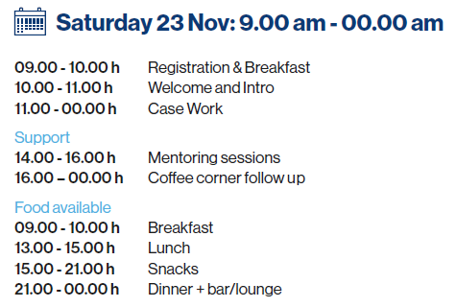
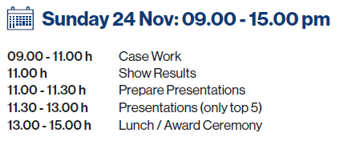
Agenda

Slide 4


Slide 5
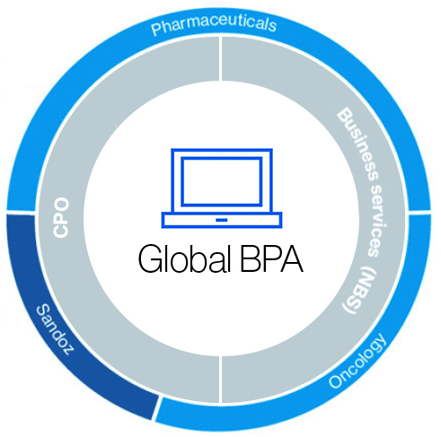
The Hub
The Hub
100% endorsement
Start up like ramp up
9 different nationalities
Team
2/3
LOCAL
talent
Kick off
April 2018
Month 0
Month 14
Month 18
Services Offer
Background
27%
23%
Mathematics & Statistics
Engineering
19%
15%
Data Scientist
BPA Consultants
Computer Science
Economics
8%
8%
Business Administration
Physics
Architects
GDD BPA

Slide 6
Forecast - Why it matters
“Reimagine medicine to improve and extend people’s lives”
Allows business to focus and deliver and be strategic about the future
Enables a more efficient allocation of our resources
Financial efficiency allows us to develop more and better drugs, while reaching more people

Slide 7
Datathon Challenge
Forecasting challenge
Clustering challenge
10 countries
95 brands
Train: from 1/2012
Test: From 8/2017 to 6/2019
Features: calendar, months since launch, expenses,...
Clustering of the time series that behave similarly
Generate information that could help you with the forecast challenge
or
Generate valuable insight for business according to your own judgement

Slide 8
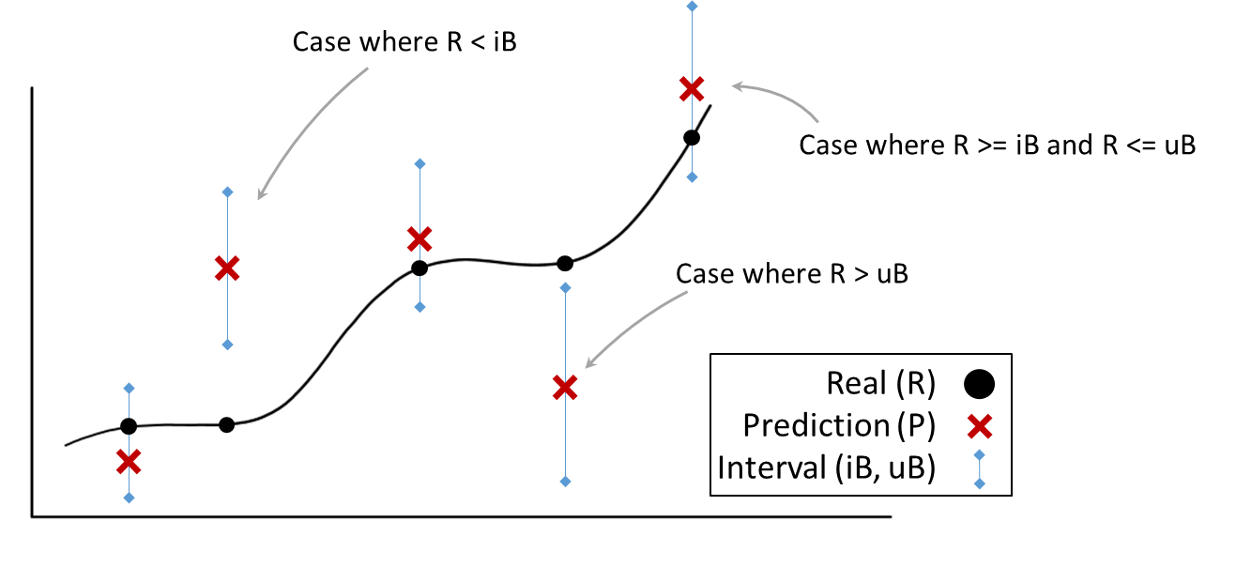
Metric Chart

Slide 9
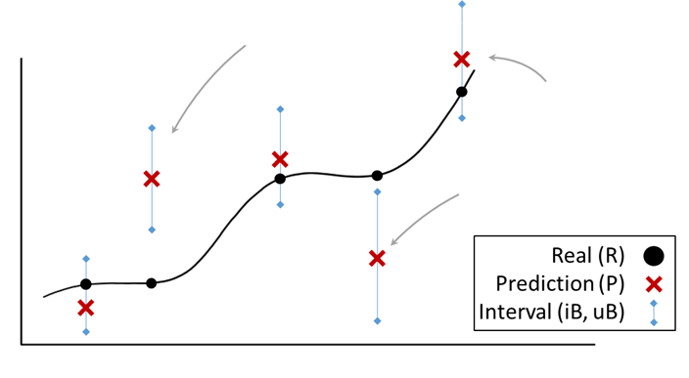



Metric Chart
$$Error= \frac{\left|R−uB\right|+ \left|R−lB\right|+ \left|R−P\right|}{\overline{R}}× \left(1.5+ 2\frac{\left|R−lB\right|}{\overline{R}}\right)$$
$$Error= \frac{\left|R−uB\right|+ \left|R−lB\right|+ \left|R−P\right|}{\overline{R}}$$
$$Error= \frac{\left|R−uB\right|+ \left|R−lB\right|+ \left|R−P\right|}{\overline{R}}× \left(1.5+ 2\frac{\left|R−uB\right|}{\overline{R}}\right)$$

Slide 10
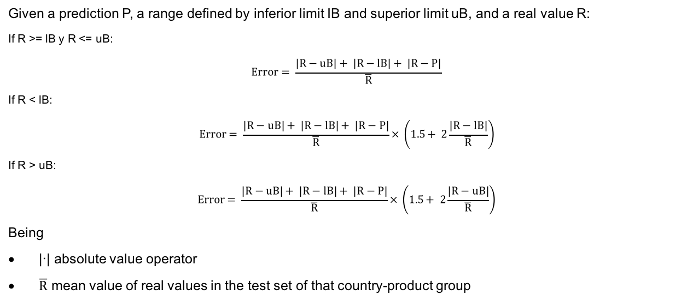
Metric Formula
Given a prediction P, a range defined by inferior limit IB and superior limit uB, and a real value R:
If R >= lB y R <= uB:
$$Error= \frac{\left|R−uB\right|+ \left|R−lB\right|+ \left|R−P\right|}{\overline{R}}$$
If R < lB:
$$Error= \frac{\left|R−uB\right|+ \left|R−lB\right|+ \left|R−P\right|}{\overline{R}}× \left(1.5+ 2\frac{\left|R−lB\right|}{\overline{R}}\right)$$
If R > uB:
$$Error= \frac{\left|R−uB\right|+ \left|R−lB\right|+ \left|R−P\right|}{\overline{R}}× \left(1.5+ 2\frac{\left|R−uB\right|}{\overline{R}}\right)$$
Being
|·| absolute value operator
$\overline{R}$ mean value of real values in the test set of that country-product group

Slide 11
Datathon Criteria
Jury Criteria:
FORECAST ACCURACY: How close is your prediction to the real value and how well the upper and lower bounds represent the uncertainty?
NON-QUANTITATIVE CRITERIA: How innovative and creative is your approach for clustering our brands? In your presentation, did you clearly communicate what you did and could answer the questions?
Top 5 teams according to the FORECAST ACCURACY metric will present to the Jury with a 10 minutes presentation + Q&A. They will show their results for both exercises.

Slide 12
Data input
Country (10): geographical break down
Brand Group (95): A pharmaceutical product
Function (10): Financial information related to:
Gross & Net Prices
Expenses = Different investment types
Volume = Target variable
Calendar variables (13)
Months from launch
Calendar variables such as number of working days, etc
Time:
Monthly/Quarterly/Yearly data from 2012
Data : available till end 7 2017

Slide 13
Submission Sample
Format:
Columns will be comma-separated
Decimal separator will be dot
Date will be a string with the format “YYYY-MM-01”

Slide 14
Submission Instructions
You will not be evaluated if your submission file contains an error. This will happen if:
The submission file contains forecast values that do not lie within the given boundaries
Your submission is incomplete or has more values than requested
You will be evaluated on your most recent submission
There is no limit to the number of submissions
The public leaderboard will be updated once every hour, except for the final hour during which it will be updated every 15 minutes.
The public leaderboard that you will see is created using a random subsample of 40% of the test data points. The official leaderboard is created using the full test set. Make sure you are not overfitting or you will drop down!

Slide 15
Data Notes and Hints
In the data set you may find recently launched brands and brands facing generic competition due to loss of exclusivity
In some brands/countries may have volume but not/low Investments or viceversa
“Usually” volume is positive and investment is negative. However negative volumes and positive investments are possible (e.g. returns, accounting changes, etc.)
Products 53, 71, 64, 69, 63 belong to the same therapeutic area (cannibalization?)
There are cases where the same molecule is used in more than one therapeutic area.
Products 3 & 45
Products 30 & 56
There might be other product combinations that have interconnected sales and you might or might not want to use any of them!

Slide 16
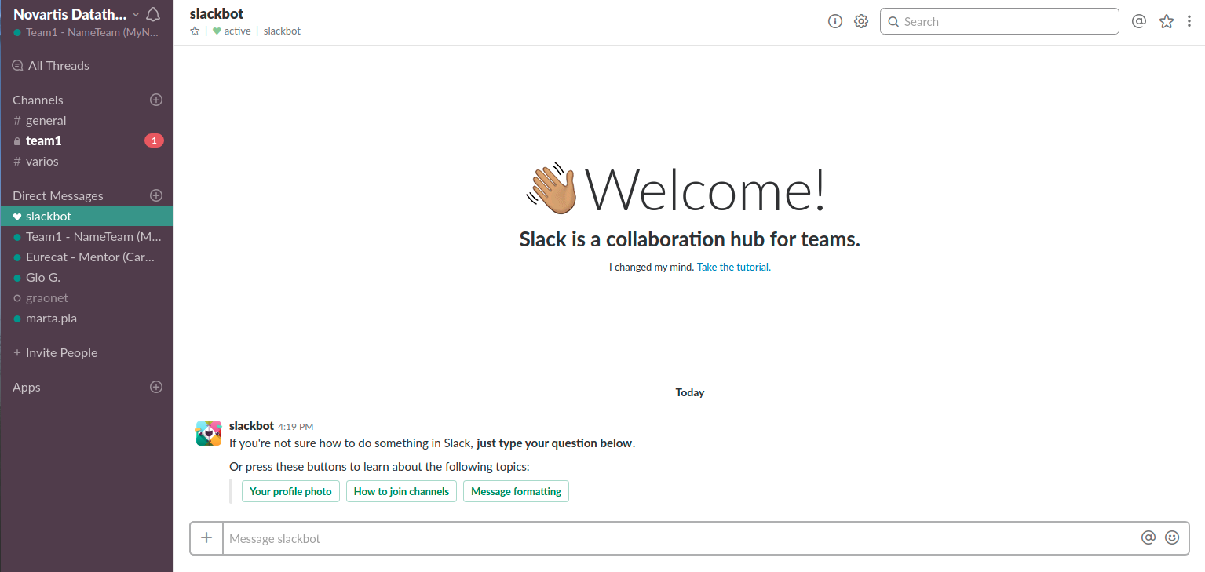
Communication Channel
username: TeamX – NameTeam (MyName)

Slide 17
Communication Channel

Slide 18
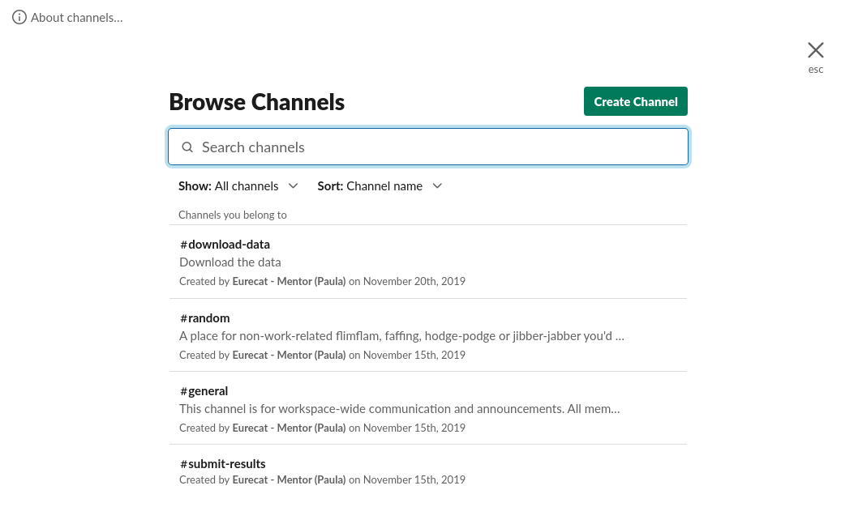
Communication Channel

Slide 19
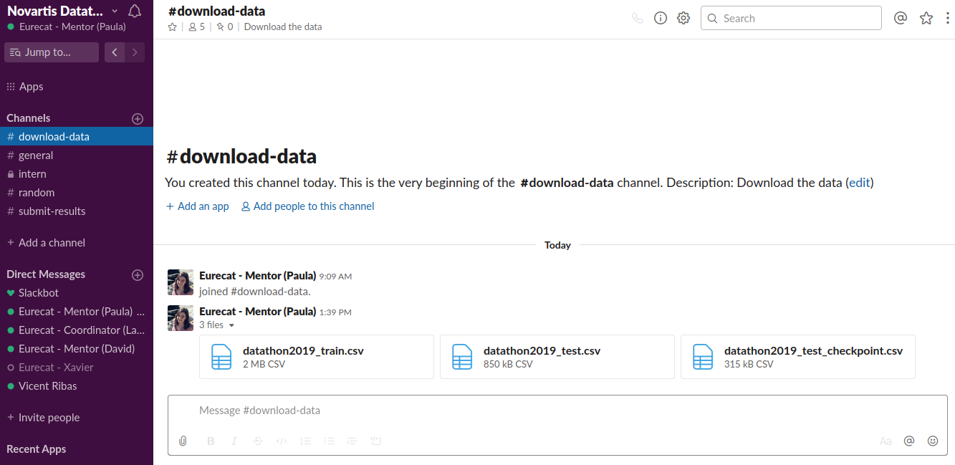
How to submit the results

Slide 20
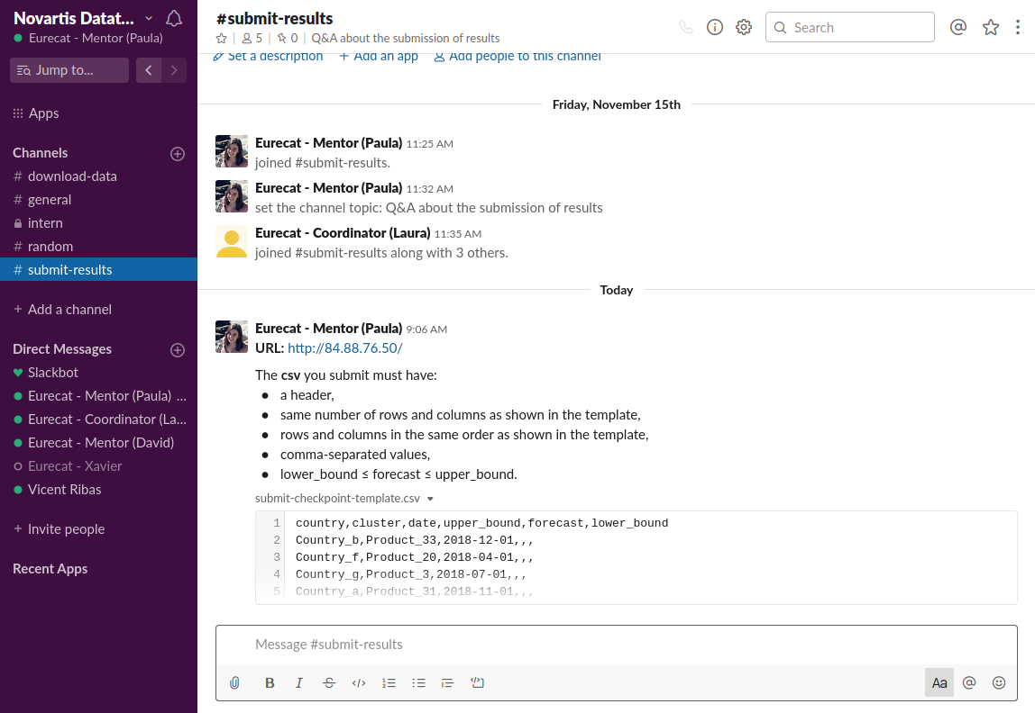
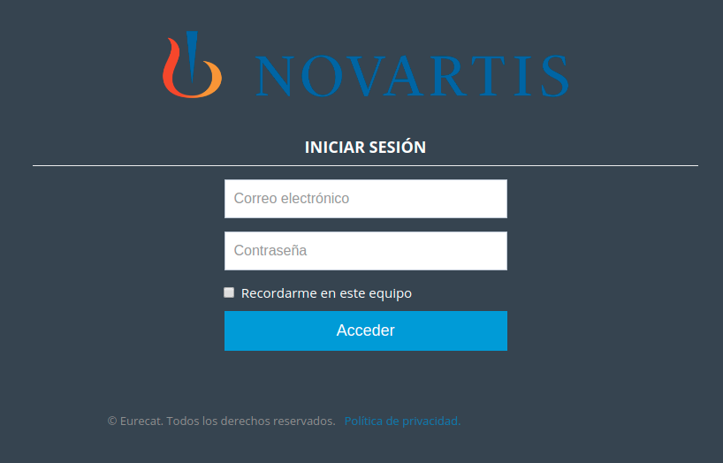
How to submit the results
Credentials
user: teamX@novartisdatathon
password: pndteamX

Slide 21
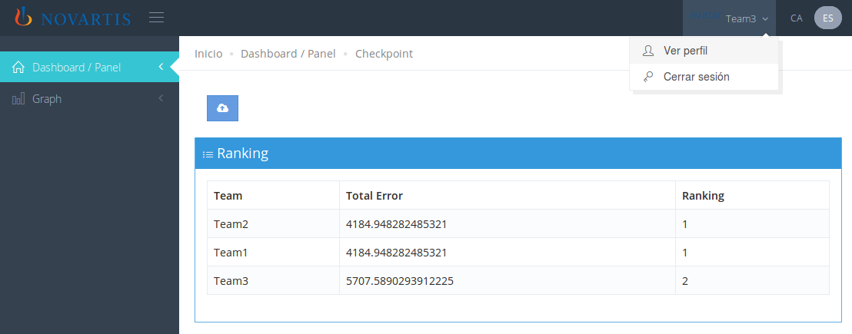
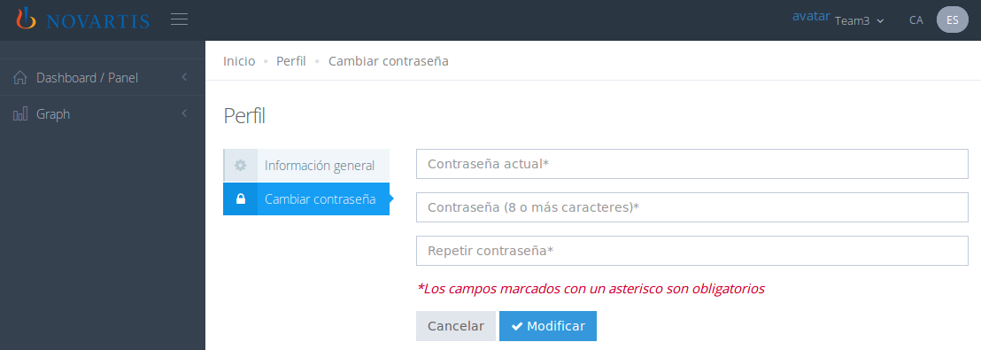
How to submit the results
Please change the password
1
2

Slide 22
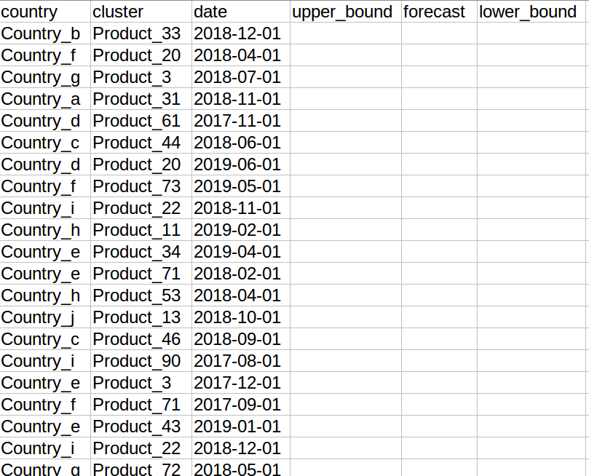
How to submit the results
The order is important

Slide 23
How to submit the results
There are 2 kind of submissions:
Checkpoint datathon2019_test_checkpoint.csv
40% of test dataset
Results calculated at the beginning of each hour based on the last submission
During the last hour (24th Nov 10:00-11:00) results will be updated every 15 minutes
Final datathon2019_test_final.csv
100% of test dataset
Results calculated once the datathon is over (24th Nov 11:00) based on the last submission

Slide 24
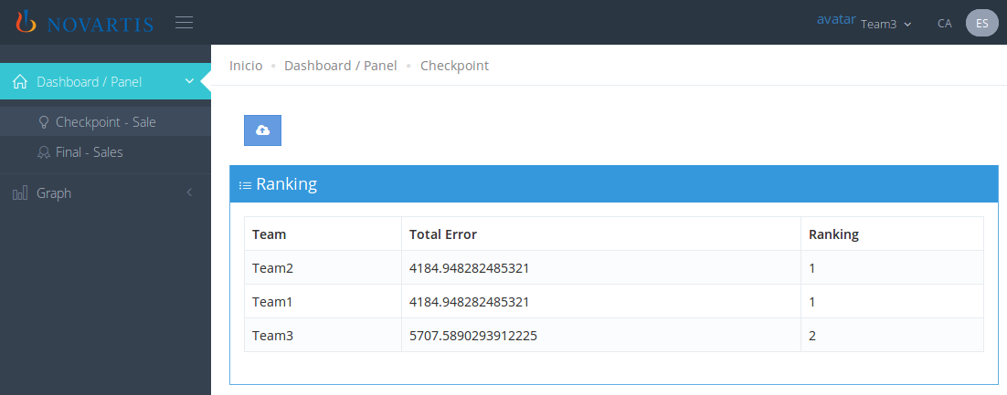
How to submit the results
Ranking

Slide 25
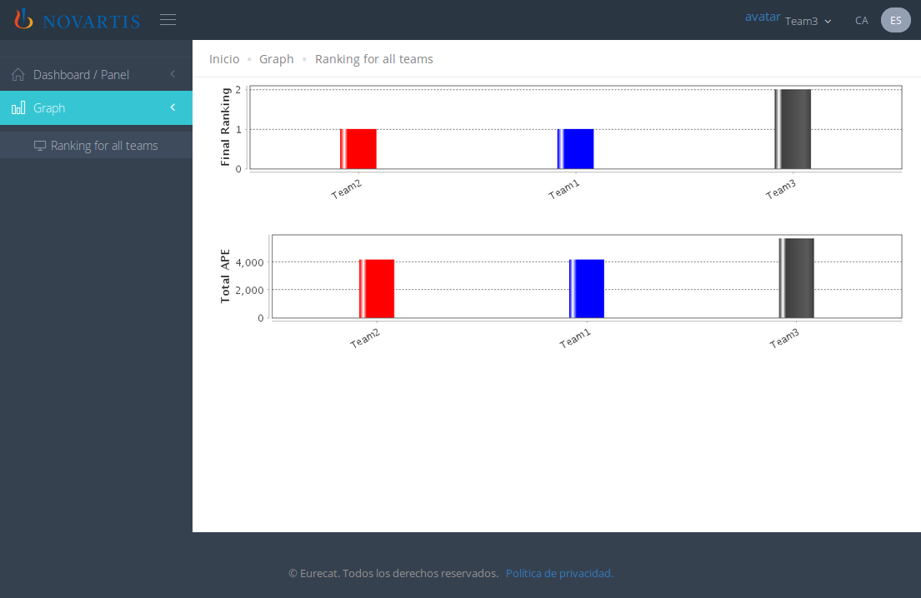
How to submit the results

Slide 26
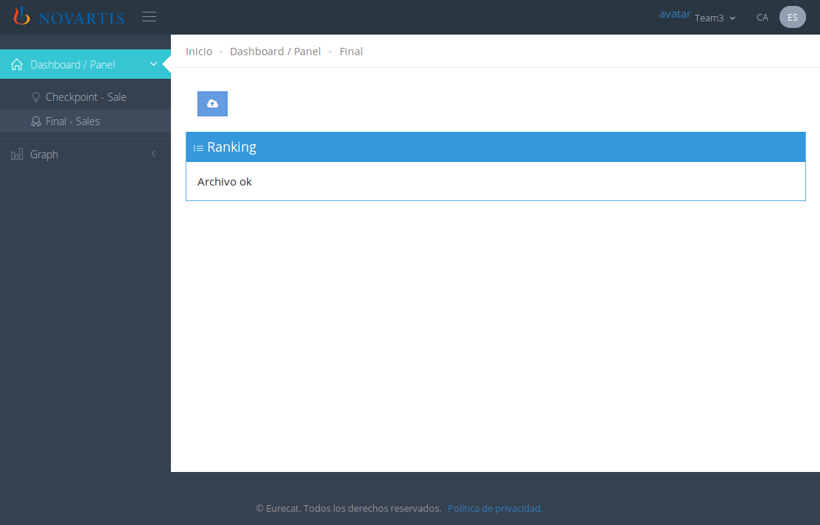
How to submit the results
Final results: Deadline 11 am
on Sunday.

Slide 27
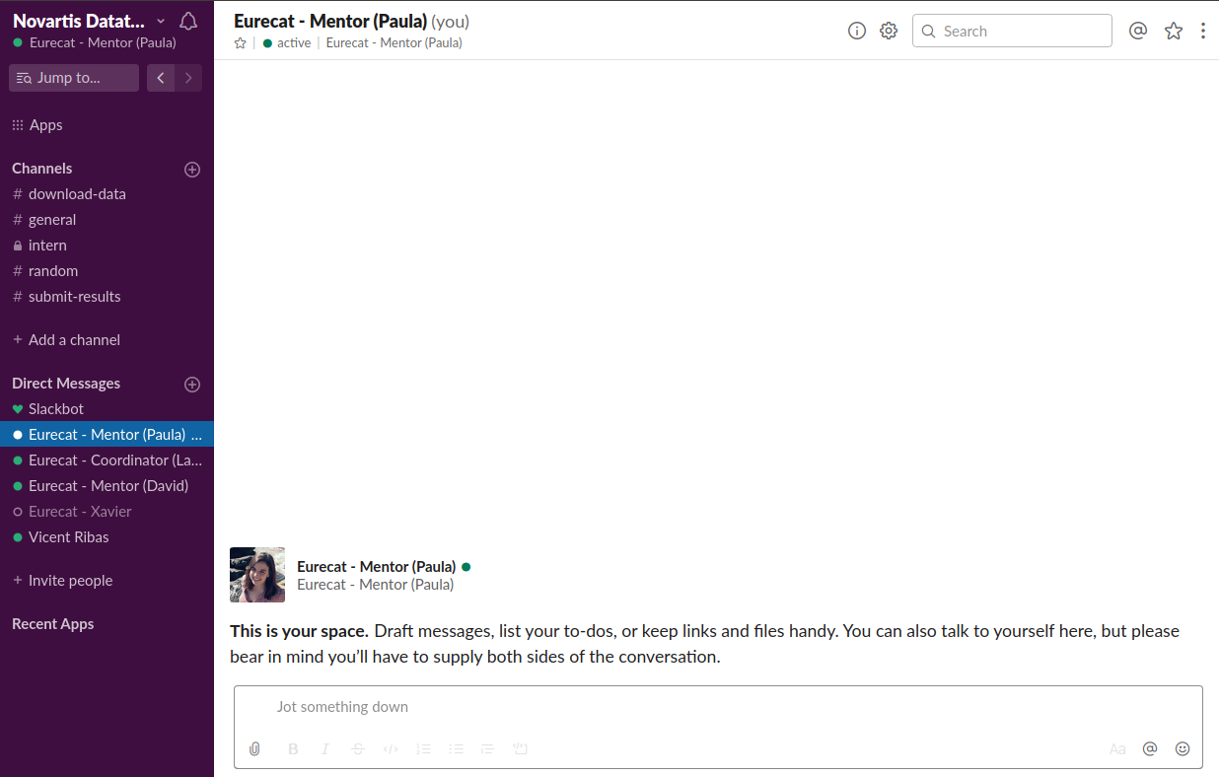
How to submit the results - Top 5
Data_Novartis_Datathon-Results_Presentation_TeamX

Slide 28
GOOD
LUCK

